Slide 1
REACT JS

Slide 2
INTRODUCTION TO REACT
React is a JavaScript library for building user interfaces.
React is used to build single-page applications.
React allows us to create reusable UI components.
Command to create react application:
npx create-react-app myapp

Slide 3
FEATURES OF REACT
Components based architecture.
ReactJS components are the building blocks of any React application and are one of the best features in ReactJS, and a single app is typically built of numerous components.

Slide 4
Benefits of components based Architecture
Reusability: Once built, components can be reused across different parts of the application.
Maintainability: Smaller components are easier to test, debug, and update.
Modularity :Components are small, independent and easy to learn.
Scalability: Component-based architecture makes it easier to scale applications by adding more components without affecting existing ones.

Slide 5
REACT JSX
JSX stands for JavaScript XML.
JSX allows us to write HTML in React.
JSX makes it easier to write and add HTML in React.

Slide 6
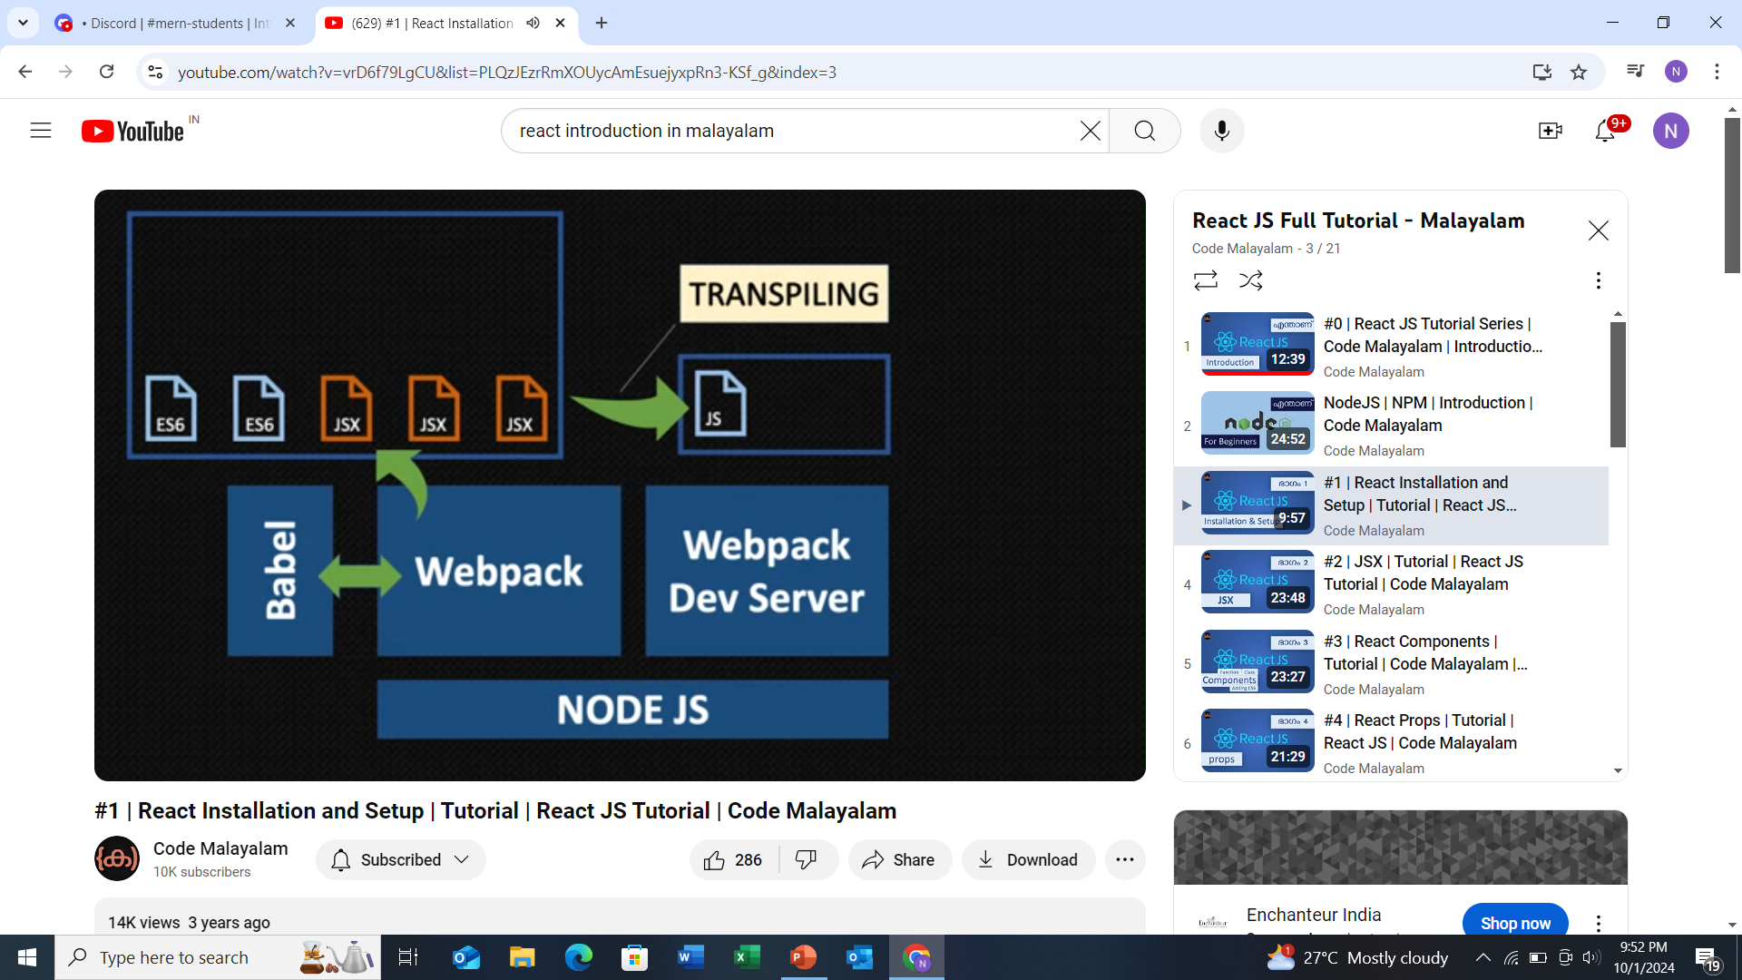

Slide 7
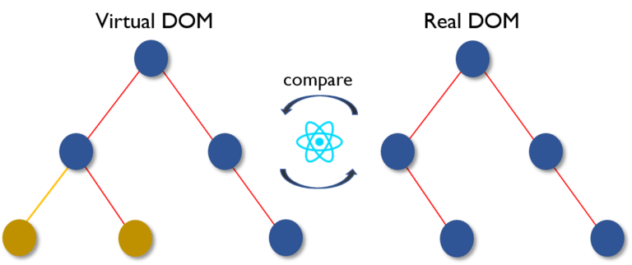
Virtual DOM

Slide 8
What is virtual DOM?
The DOM (Document Object Model) is a representation of the structure of a web page, which browsers use to render the page on screen.
Every HTML element (like <div>, <p>, etc.) is represented as a node in the DOM tree.
Updating the DOM directly (like with JavaScript) can be slow because even small changes require the browser to re-render large parts of the webpage.
To address this, React uses the Virtual DOM, which is a lightweight, in-memory representation of the real DOM. It's a copy of the DOM that React can quickly manipulate without immediately affecting the actual DOM.

Slide 9
REACT COMPONENTS
React components are the building blocks of a React application.
They allow you to break the UI into independent, reusable pieces.
Components come in two types, Class components and Function components.

Slide 10
REACT PROPS
Props are used to pass data from one component to another.
Props are immutable, meaning the receiving component cannot modify them.
They allow components to be reusable by passing different data into them.

Slide 11
REACT STATE
In React, state refers to an object that holds data or information about the component and influences what is rendered on the screen.
const [count, setCount] = useState(0);
Here count for storing data and setCount for updating data.

Slide 12
REACT EVENTS
Just like HTML DOM events, React can perform actions based on user events.
React has the same events as HTML: click, change, mouseover etc.

Slide 13
REACT HOOKS
Hooks allow function components to have access to state and other React features.
UseState: Hook allows us to track state in a function component.
useEffect: Hook allows you to perform side effects in your components.

Slide 14
REACT ROUTING
Create React App doesn't include page routing.
React Router is the most popular solution.
Command to add react route : npm i react-router-dom

Slide 15
THANK YOU

